Slide 1
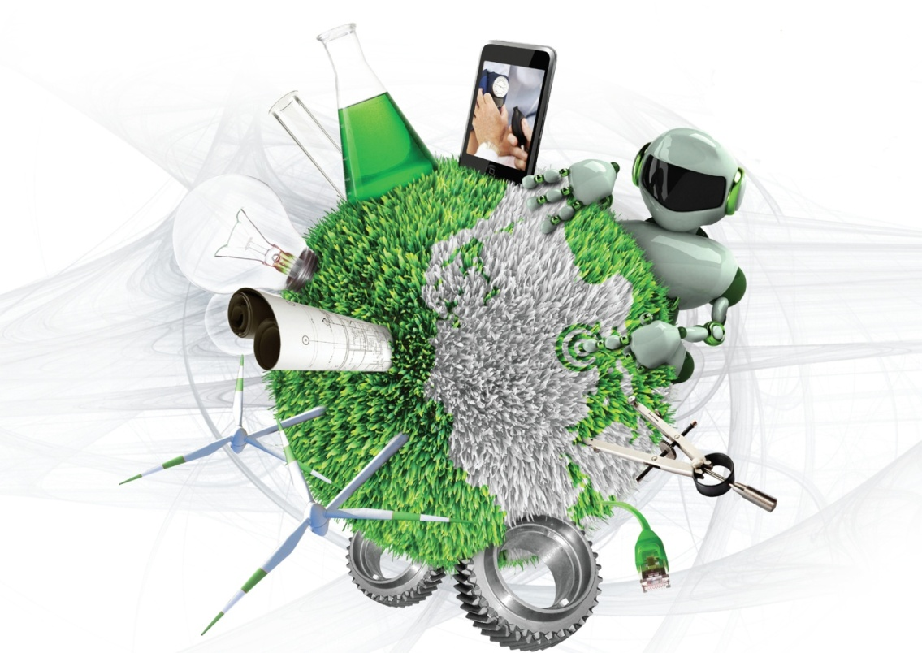
Lecture 1: Systems – what and why?
<number> | 2010

Slide 2
Covered in this lecture
Systems and systems thinking
Why we use Systems Engineering
Systems from “cradle to grave”
<number> | 2010

Slide 3
Systems and systems thinking
<number> | 2010

Slide 4
Definition of a System
“a combination of interacting elements organized to achieve one or more stated purpose”
“an integrated set of elements, subsystems, or assemblies that accomplish a defined objective. These elements include products (hardware, software, firmware), processes, people, information, techniques, facilities, services, and other support elements.
From: INCOSE
<number> | 2010

Slide 5
The elements of a system
Systems are composed of components, attributes, and relationships. These are described as follows:
  Components are the parts of a system
  Attributes are the properties (characteristics, configuration, qualities, powers, constraints and states)
  Relationships between pairs of linked components are the result of engineering the attributes of both components so that the pairs operates together effectively in contributing to the system’s purpose(s)
<number> | 2010

Slide 6
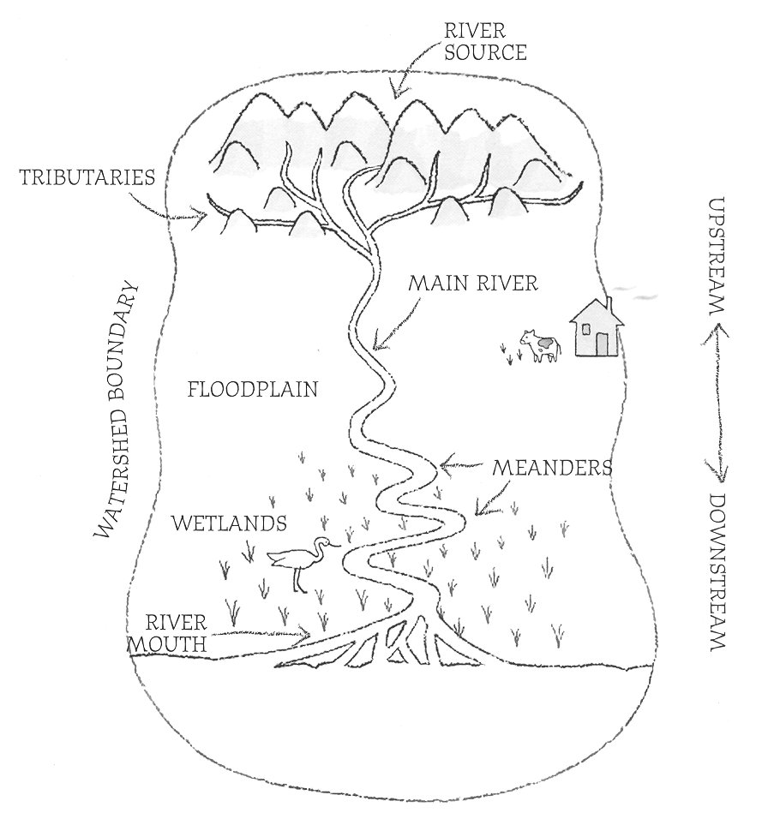




Which of these are systems? What are their purpose; the main components; attributes and relationships?
<number> | 2010
Notes:
River system:
Purpose: Transporting water from source to oceans
Components:
Attributes:
Relationships:
Crowd:
A random crowd is not a system: No purpose, relationships
Operation system:
Purpose:
Components:
Attributes:
Relationships:
A bridge:
Purpose: Provide structure for transportation across water
Components:
Attributes:
Relationships:
IHA school:
Purpose:
Components:
Attributes:
Relationships:
WHAT IS A RIVER SYSTEM?
Every river is part of a larger system-a watershed, which is the land drained by a river and its tributaries. Rivers are large natural streams of water flowing in channels and emptying into larger bodies of water. This diagram shows some common characteristics of a river system. Every river is different, however, so not all rivers may look exactly like this illustration.
The river source, also called the headwaters, is the beginning of a river. Often located in mountains, the source may be fed by an under- ground spring, or by runoff from rain, snowmelt, or glacial melt.
The river mouth is the place where a river flows into a larger body of water, such as another river, a lake, or an ocean.
Upstream is in the direction of or nearer to the source of a river.
Downstream is in the direction of or nearer to the mouth of a river.
Wetlands are low-lying areas saturated with water for long enough periods to support vegetation adapted to wet conditions. Wetlands help maintain river quality by filtering out pollutants and sediments, and regulating nutrient flow.
A fully-developed floodplain is relatively flat land stretching from either side of a river, which may flood during heavy rain or snowmelt. Built of materials deposited by a river, floodplain soil is often rich in nutrients and ideal for growing food.
A tributary is a smaller stream or river that joins a larger stream or main river.
A watershed boundary, also called a drainage divide, marks the outer- most limit of a watershed. A watershed is a tract of land drained by a river and its tributaries. Anything that affects a watershed may eventually impact its tributaries and river as well as the water body at the mouth of the river. People's actions within a watershed can affect the overall quality of its rivers.
The main river is the primary channel and course of a river.
A meander is a loop in a river channel. A meandering river winds back and forth, rather than following a straight course.
You can find an interactive version of this river system at www.NationalGeographic.com/geographyaction

Slide 7
Systems of Systems (SoS)
SoS are systems-of-interest whose system elements are themselves system.
SoS are defined as an interoperating collection of component systems that produce results unachievable by the individual systems alone.
Notes:
Systems are man-made, created and utilized to provide services in defined environments for the benefit of users and other stakeholders. These systems may. be configured with one or more of the following: hardware, software, humans, processes (e.g., review process), procedures (e.g., operator instructions), facilities, and naturally occurring entities (e.g., water, organisms, minerals). In practice, they are thought of as products or services. The perception and definition of a particular system, its architecture and its system elements depend on an observer’s interests and responsibilities. One person’s system-of-interest can be viewed as a system element in another person’s system-of-interest. Conversely, it can be viewed as being part of the environment of operation for another person’s system-of-interest.

Slide 8
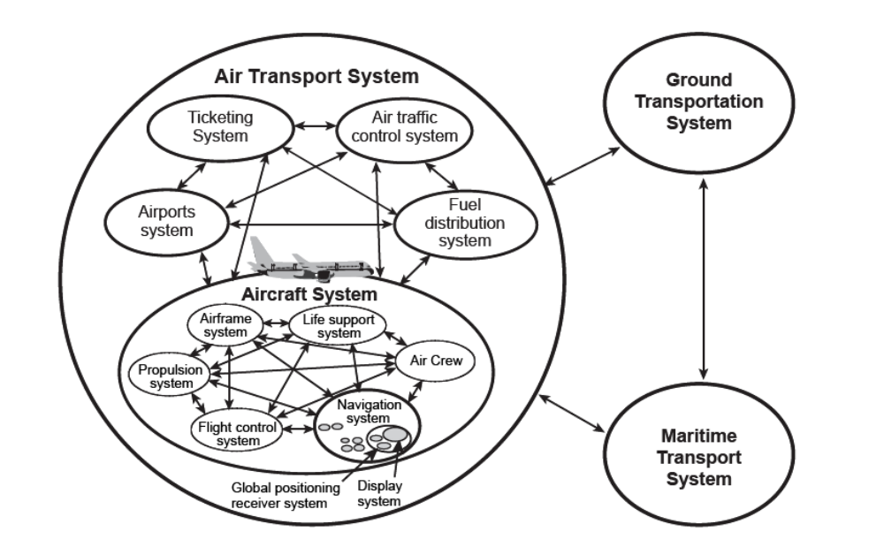
Example: Transport System-of-Systems
Notes:
The figure shows an example of the multitude of perceivable systems-of-interest in an aircraft and its environment of operation within a transport SoS.
The Global Positioning System (GPS), which is an integral part of the navigation system on board an aircraft, is a system in its own right rivaling the complexity of the air transportation system. Another characteristic of SoS is that the component systems may be part of other unrelated systems. For instance, the GPS may be an integral part of automobile navigation systems.

Slide 9
Systems of Systems
Challenges with development of SoS:
  System elements operate independently
  System elements have different life cycles
  The initial requirements are likely to be ambiguous
  Complexity is a major issue
  Management can overshadow engineering
  Fuzzy boundaries cause confusion
  SoS engineering is never finished
Notes:
Each system in a SoS is likely to be operational in its own right.
SoS involves more than one system element. Some of the system elements are possibly in their development life cycle while others are already deployed as operational. In extreme cases, older systems elements in SoS might be scheduled for disposal before newer system elements are deployed.
The requirements for a SoS can be very explicit for deployed system elements. But for system elements that are still in the design stage, the requirements are usually no more explicit than the system element requirements. Requirements for SoS mature as the system elements mature.
As system elements are added, the complexity of system interaction grows in a non-linear fashion. Furthermore, conflicting or missing interface standards can make it hard to define data exchanges across system element interfaces.
Since each system element has its own product/project office, the coordination of requirements, budget constraints, schedules, interfaces, and technology upgrades further complicate the development of SoS.
Unless someone defines and controls the scope of a SoS and manages the boundaries of system elements, no one controls the definition of the external interfaces.
Even after all system elements of a SoS are deployed, product/project management must continue to account for changes in the various system element life cycles, such as new technologies that impact one or more system elements, and normal system replacement due to preplanned product improvement.

Slide 10
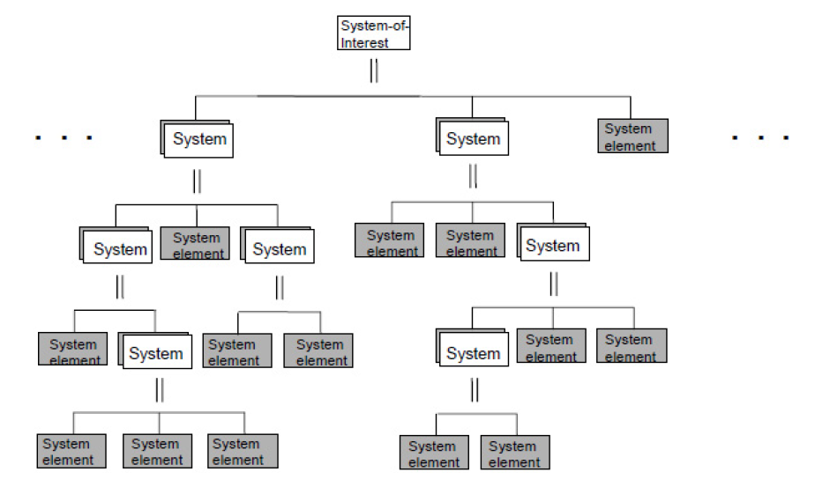
The hierarchy within a system
<number> | 2010

Slide 11
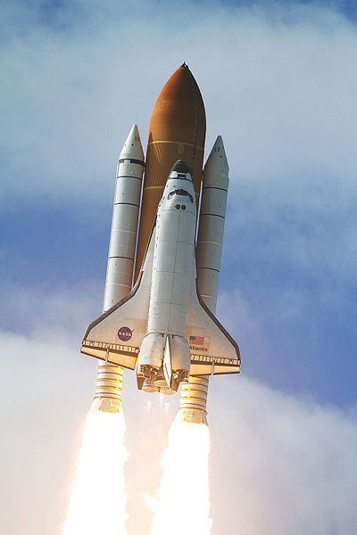
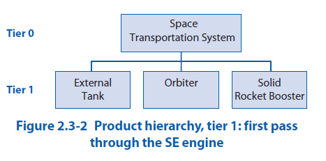
Example: Space
Transportation System
From: NASA Systems Engineering Handbook
<number> | 2010
Notes:
Example of applying the SE engine on the Space Transportation System.

Slide 12
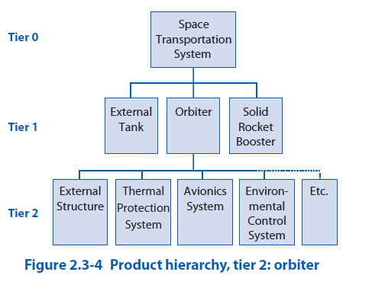
Example: Space
Transportation System
From: NASA Systems Engineering Handbook
<number> | 2010
Notes:
Example of applying the SE engine on the Space Transportation System.

Slide 13
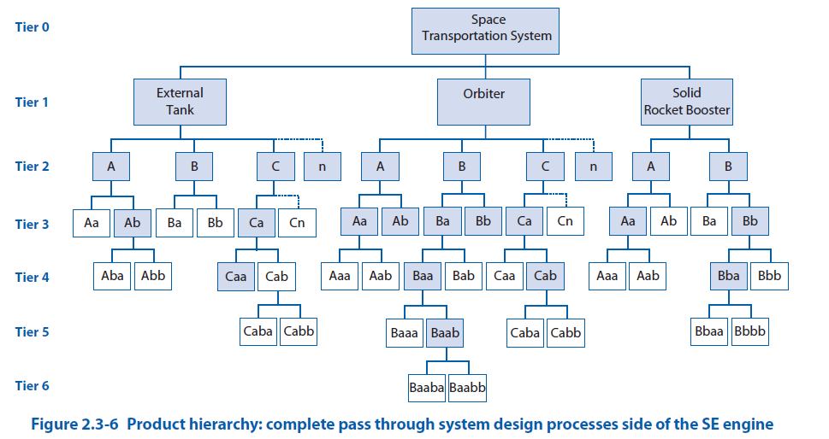
Example: Space
Transportation System
From: NASA Systems Engineering Handbook
<number> | 2010
Notes:
Example of applying the SE engine on the Space Transportation System.

Slide 14
Why we use Systems Engineering
<number> | 2010

Slide 15
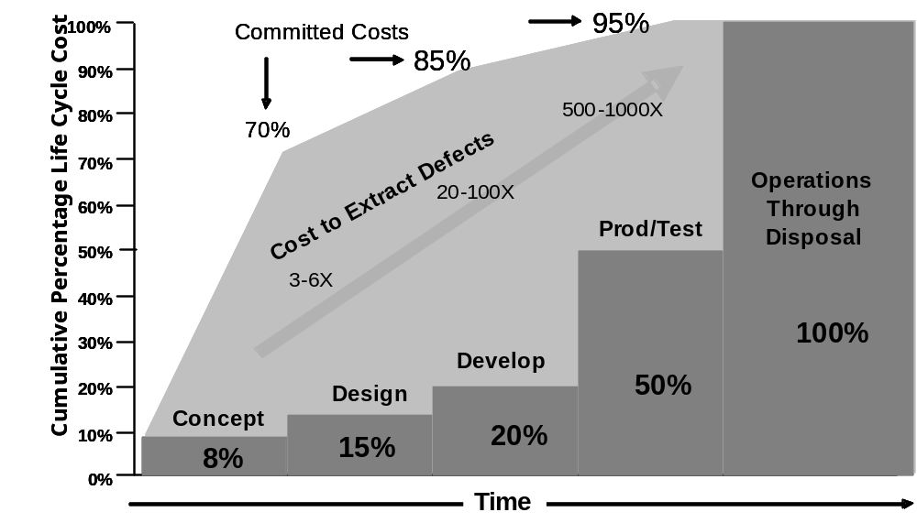
Use of Systems Engineering
Committed Life Cycle Cost against Time
Systems engineering emerged as an effective way to manage complexity and change. Reducing the risk associated with new systems or modifications to complex systems continues to be primary goal of the systems engineer.
Notes:
The systems engineering discipline emerged as an effective way to manage complexity and change. Both complexity and change have escalated in our products, services, and society. Reducing the risk associated with new systems or modifications to complex systems continues to be a primary goal of the systems engineer. The percentages along the time line represent the actual life cycle cost (LCC) accrued over time – which means that the concept phase of a new system averages 8% of the total LCC. The curve for committed costs indicates the amount of LCC committed by the decisions taken. The curve indicates that when 20% of the actual cost has been accrued, 80% of the total LCC has already been determined based on a statistical analysis performed on projects in the US DoD. The light arrow under the curve reminds us that errors are less expensive to remove early in the lifecycle.
This figure also demonstrates the consequences of taking early decisions without the benefit of good information and analysis. Systems engineering extends the effort performed in concept exploration and design to exceed the percentages shown in the cumulative effort step-curve and reduce the risk of hasty commitments without adequate study. The recursive nature of modern development means that the execution of the various life cycle phases is not linear as illustrated – but the consequence of ill-formed decisions is the same.

Slide 16
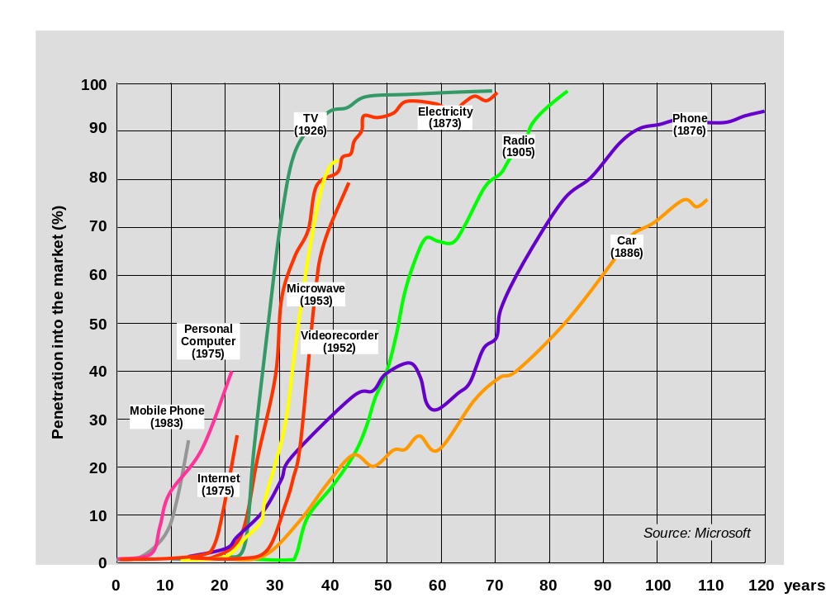
From prototype to market penetration
Notes:
In the last century, the time from prototype to significant market penetration is dramatically reduced from Microsoft
Another factor driving the need for systems engineering is that the time from prototype to significant market penetration of a new product has dropped by more than a factor of four in the past 50 years.
Complexity has an impact on innovation. Few new products represent the big-bang introduction of new invention – most products and services are the result of incremental improvement. This means that the life cycle of today’s products and services is longer and subject to increasing uncertainty. A well-defined systems engineering process becomes critical to establishing and maintaining a competitive edge in the 21st century.

Slide 17
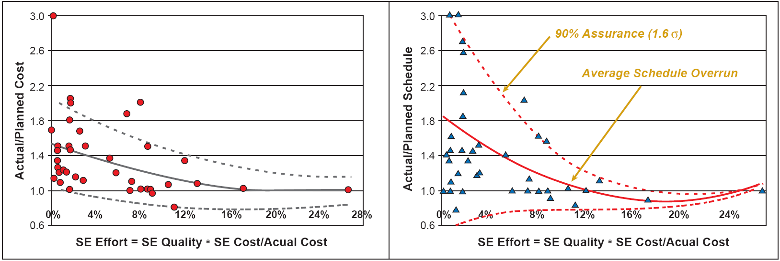
Value of Systems Engineering
Cost and schedule overruns correlated with systems engineering effort
Cost and schedule overruns lessens with increasing systems engineering effort
Variance in the cost and schedule overruns also lessens with increasing systems engineering effort
Notes:
A study researching the return on investment from using systems engineering was conducted by the INCOSE Systems Engineering Center of Excellence beginning in 2001. The results uncovered an inverse correlation between cost and schedule overruns and the amount of systems engineering effort (SEE). As illustrated in the graph to the left in the figure, cost overrun lessens with increasing SEE and appears to minimize at something greater than 10% SEE. Variance in the cost overrun also lessens with increasing SEE. At low SEE, a project has difficulty predicting its overrun, which may be between 0% (actual = planned) and 200% (actual = 3 x planned). At 12% SEE, the project cost is more predictable, falling between minus 20% (actual = 0.80 x planned) and 41% (actual = 1.41 x planned). The dashed lines are the 90th percentile when assuming a normal distribution.
Schedule overrun on the reported projects is illustrated in the right-hand graph in Figure 2-5. Two effects are apparent: Schedule overrun lessens with increasing SEE. Overrun appears to minimize at something greater than 10% SEE, although few data points exist to support a reliable calculation. The solid line is the least-squares trend line for a second order curve. Variance in the schedule overrun also lessens with increasing SEE. At low SEE, a project has difficulty predicting its overrun, which may be between minus 35% (actual = 0.65 x planned) and 300% (actual = 4 x planned). At 12% SEE, the project cost is more predictable, falling between minus 22% (actual = 0.78 x planned) and 22% (actual = 1.22 x planned). The dashed lines are the 90th percentile when assuming a normal distribution.

Slide 18
Systems from cradle to grave
Life-cycle model
<number> | 2010

Slide 19
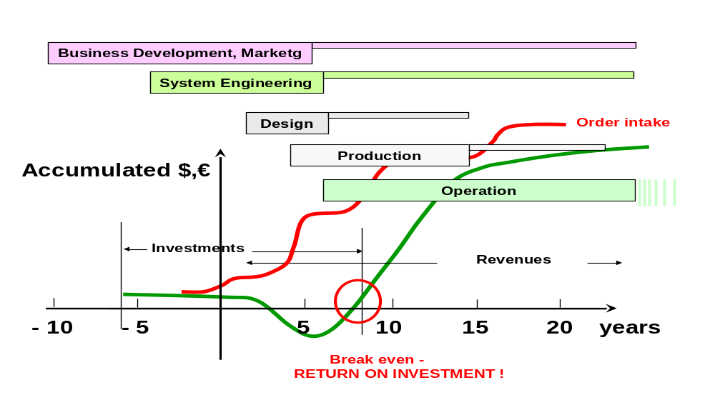
Generic Business life-cycle
Every system or product life cycle consists of the business aspect (business case), the budget aspect (funding) and the technical aspect (product)
The systems engineer creates technical solutions that are consistent with the business case and the funding constraints
Notes:
System integrity requires that these three aspects are in balance and given equal emphasis at all decision gate reviews. For example, when the Iridium project started in the late 1980s the concept of satellite-based mobile phones was a breakthrough, and would clearly capture a significant market share. Over the next dozen years, the technical reviews ensured a highly successful technical solution. In fact, in the first decade of the 21st century, the Iridium project is proving to be a good business venture for all except for the original team who had to sell all the assets — at about two percent of their investment — through the bankruptcy court. The original team lost sight of the competition and changing consumer patterns that substantially altered the original business case. Figure 3-1 highlights two critical parameters that engineers sometimes lose sight of: time to break even (indicated by red circle) and Return on Investment (ROI; indicated by green line (lower curve)).

Slide 20
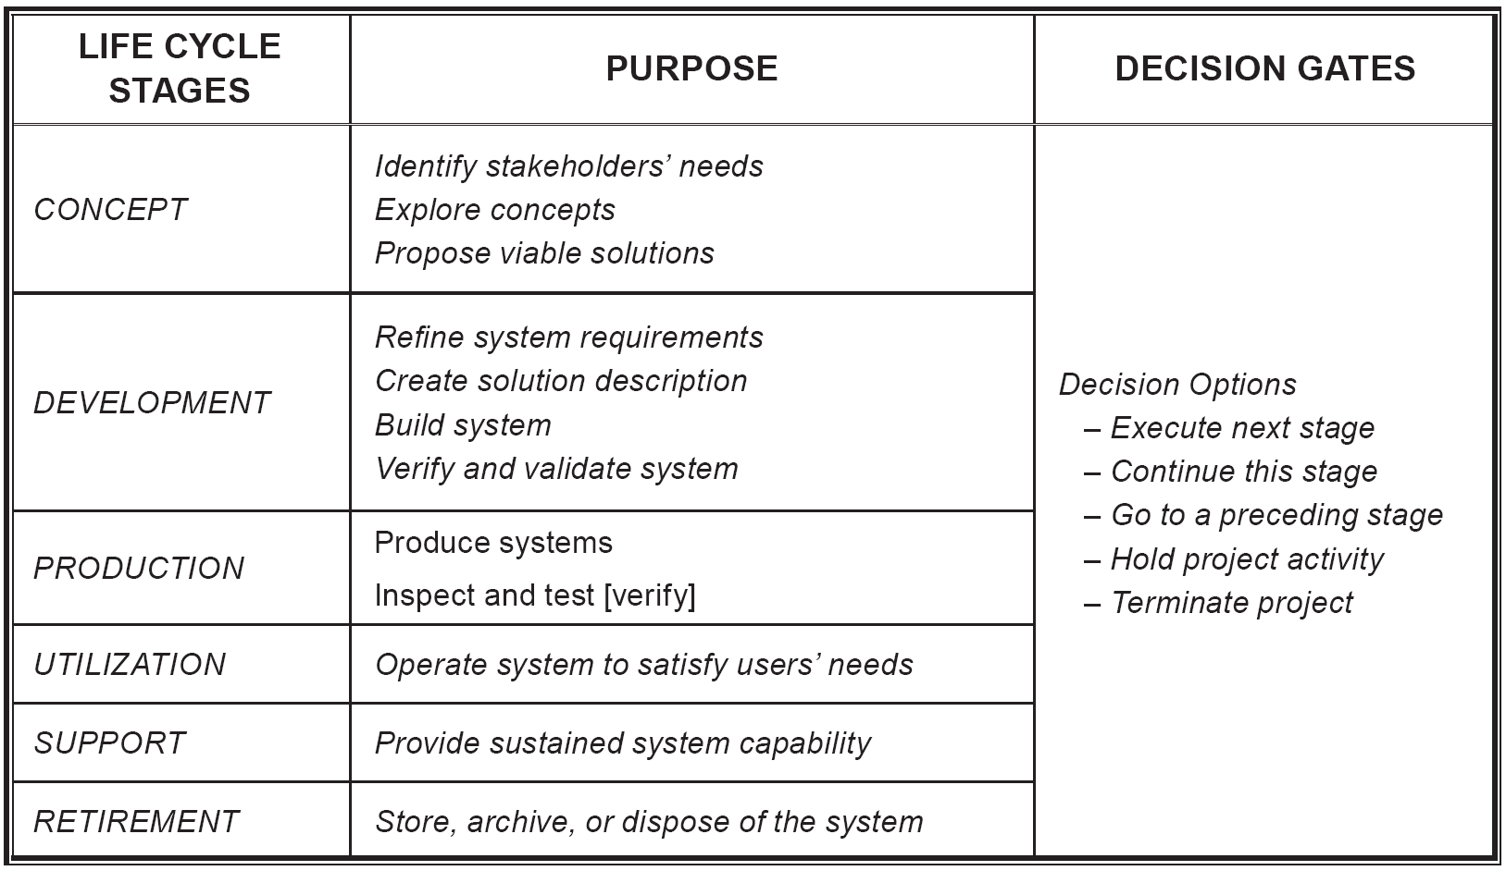
Life-cycle stages
Notes:
The table lists the six life cycle stages that are identified in ISO/IEC 15288. Then purpose of each is briefly identified in the table, and the options from decision gates events are indicated. Note that stages can overlap, and the utilization and support stages run in parallel. Note also that the outcome possibilities for decision gates are the same for all decision gates, from the first in the concept review to the last one in the retirement stage. Subsequent chapters of this handbook will define processes and activities to meet the objectives of these lifecycle stages.
Take a look at the text book page 26

Slide 21
Decision Gates
Decision Gates (control gates, milestones, reviews) represent major decision points in the system life cycle
Objectives:
  Ensure business and technical baselines are acceptable and will lead to satisfactory verification and validation
  Ensure that the risk of proceeding to the next step is acceptable
  Continue to foster buyer and seller teamwork
Notes:
Decision gates address the following questions: • Does the project deliverable still satisfy the business case? • Is it affordable? • Can it be delivered when needed?
Decision gates represent major decision points in the system life cycle. They ensure that new activities are not pursued until the previously scheduled activities, on which new ones depend, are satisfactorily completed and placed under configuration control. Decision gate approval follows review by qualified experts and involved stakeholders and is based on hard evidence of compliance to the criteria of the review.
There are at least two decision gates in any project: authority to proceed and final acceptance of the project deliverable. The project team needs to decide which life cycle stages are appropriate for their project and which decision gates beyond the basic two are needed. Each decision must have a beneficial purpose; “pro-forma” reviews waste everyone’s time. Even in agile development frequent interaction with the customer may minimize, but not eliminate, the need for decision gates. The consequences of conducting a superficial review, omitting a critical discipline, or skipping a decision gate altogether are usually long-term and costly.

Slide 22
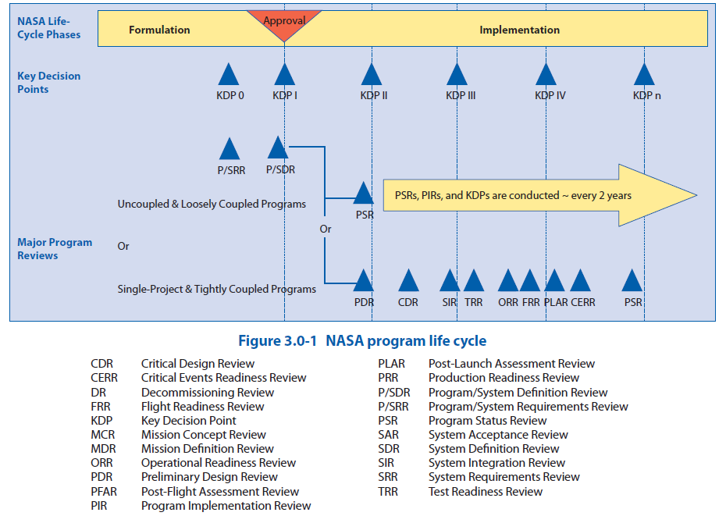
<number> | 2010
From: NASA Systems Engineering Handbook

Slide 23
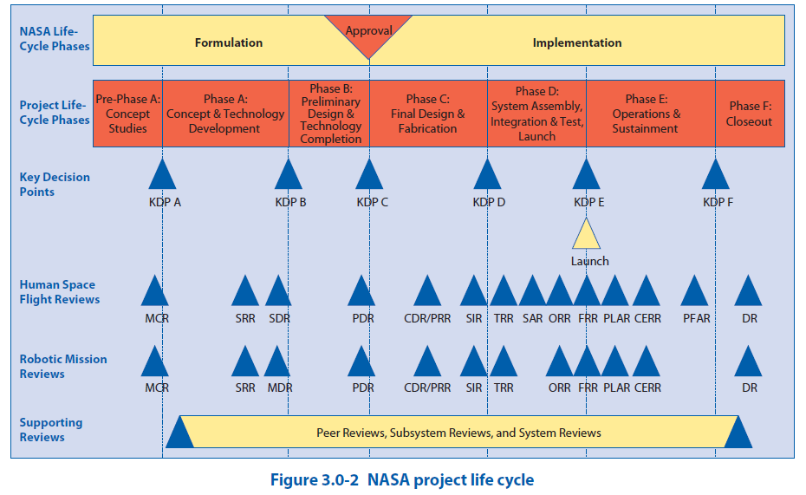
From: NASA Systems Engineering Handbook
<number> | 2010

Slide 24
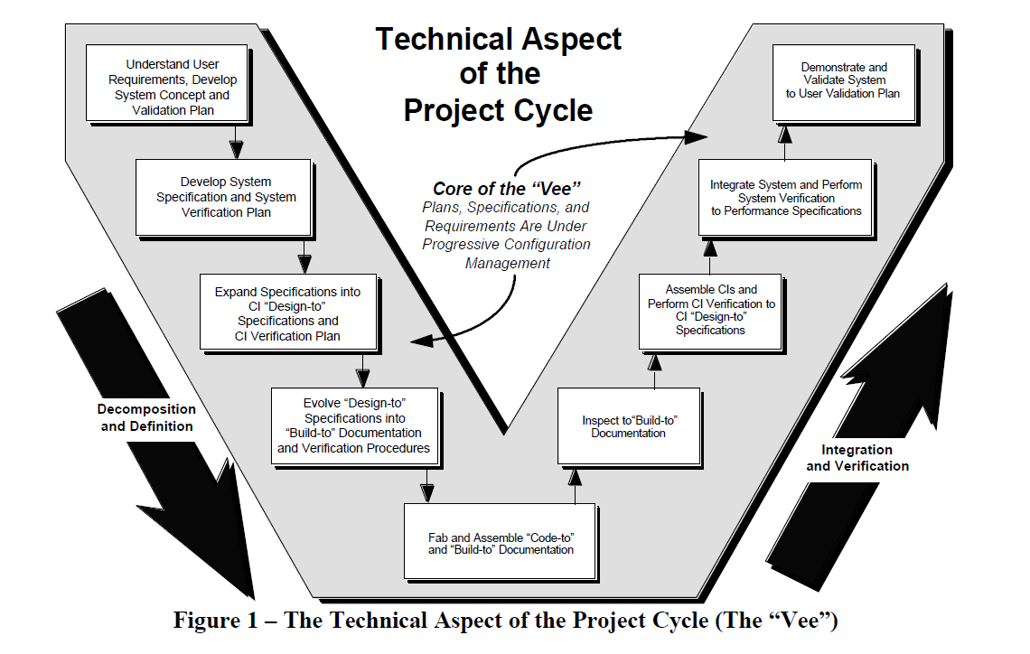
”Vee”-model
From: Forsberg, System Engineering for faster, cheaper, better
<number> | 2010
Notes:
One of a number of recognized life-cycle models e.g. waterfall, spiral, Vee, Agile.
Useful for defining start, stop and process activities. The Vee model provides a powerful illustration fot eh SE activities during the life-cycle stages.

Slide 25
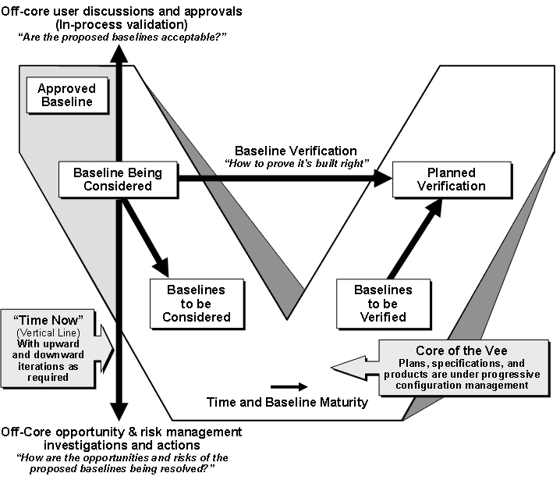
Left side of the Vee model
Notes:
The Vee model provides a useful illustration of the systems engineering activities during the life cycle stages. In the Vee model, time and system maturity proceed from left to right. The core of the Vee depicts the evolving baseline from user requirements agreement to identification of a system concept to definition of systems components that will comprise the final product. With time moving to the right and with the system maturity shown vertically, the evolving baseline defines the left side of the core of the Vee, as shown in figure 3-3. As entities are constructed, verified and integrated, the right side of the core of the Vee is executed.
Since one can never go backward in time, all iterations in the Vee are performed on the vertical “time now” line. Upward iterations involve the stakeholders and are the in-process validation activities that assure that the proposed baselines are acceptable. The downward vertical iterations are the essential off-core opportunity and risk management investigations and actions.
In each stage of the system life cycle the systems engineering process iterates to ensure that a concept or design is feasible, and that the stakeholders remain supportive of the solution as it evolves. In the following paragraphs, the text in italics has been taken from ISO/IEC 15288, Appendix B, where detailed activities and outcomes for each life cycle stage are itemized.

Slide 26
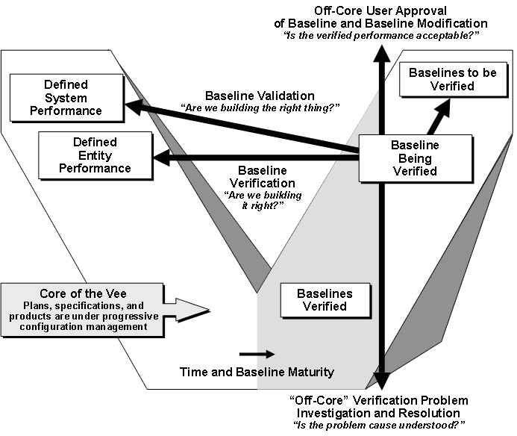
Right side of the Vee model
Notes:
The Vee model provides a useful illustration of the systems engineering activities during the life cycle stages. In the Vee model, time and system maturity proceed from left to right. The core of the Vee depicts the evolving baseline from user requirements agreement to identification of a system concept to definition of systems components that will comprise the final product. With time moving to the right and with the system maturity shown vertically, the evolving baseline defines the left side of the core of the Vee, as shown in figure 3-3. As entities are constructed, verified and integrated, the right side of the core of the Vee is executed.
Since one can never go backward in time, all iterations in the Vee are performed on the vertical “time now” line. Upward iterations involve the stakeholders and are the in-process validation activities that assure that the proposed baselines are acceptable. The downward vertical iterations are the essential off-core opportunity and risk management investigations and actions.
In each stage of the system life cycle the systems engineering process iterates to ensure that a concept or design is feasible, and that the stakeholders remain supportive of the solution as it evolves. In the following paragraphs, the text in italics has been taken from ISO/IEC 15288, Appendix B, where detailed activities and outcomes for each life cycle stage are itemized.

